Slide 1

1- Overview
KU | Fall 2018 | Drew Davidson

Slide 2
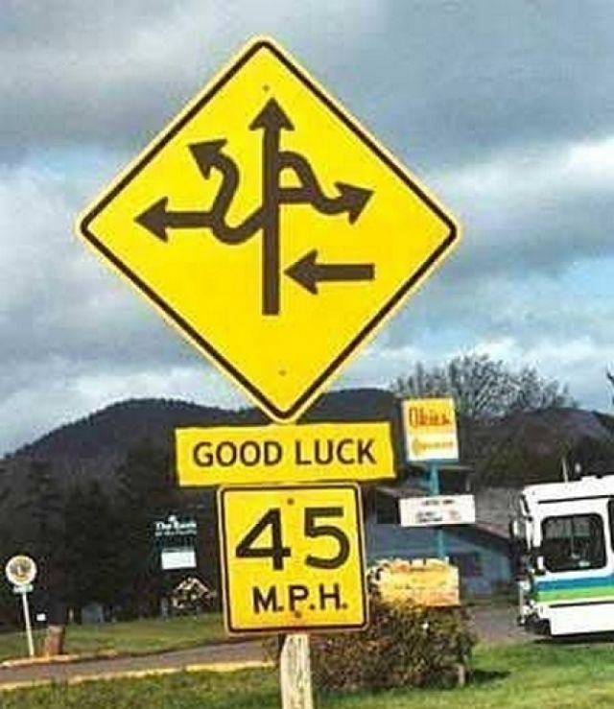
Today’s Lecture: Roadmap
Apologies to my
EECS700 students ☹
Getting to know us
About you, about me
Course Overview
A bit about the logistics
A bit about the material
Dive right in to the content
DFAs - intuition
DFA Visualization
Project 1

Slide 3
About You – Entry Survey
Questions will be posted on Blackboard tonight
Helps me to get to know you a bit, helps you to direct the course a bit

Slide 4
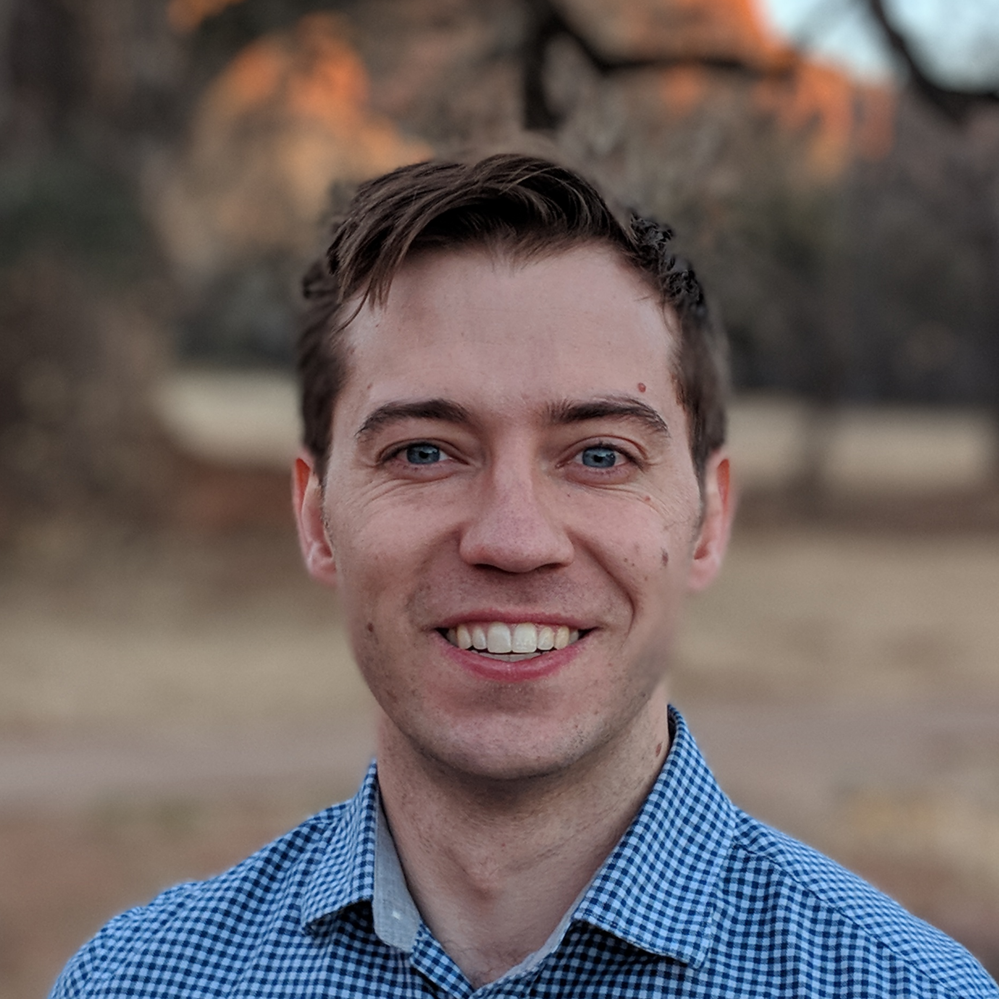

About Me – What to Call Me
Officially:
Assistant Professor Andrew Joseph Davidson
What I prefer to be called:
Drew
Professor Davidson
Dr. Davidson
What I prefer not to be called:
“Andrew” (or “Andy”, etc.)
“Dr. Drew”
My top preference
Drew (it me)
Dr. Drew (Extremely not me) [1]
[1]: Credit: www.podcastone.com/Dr-Drew-Show

Slide 5
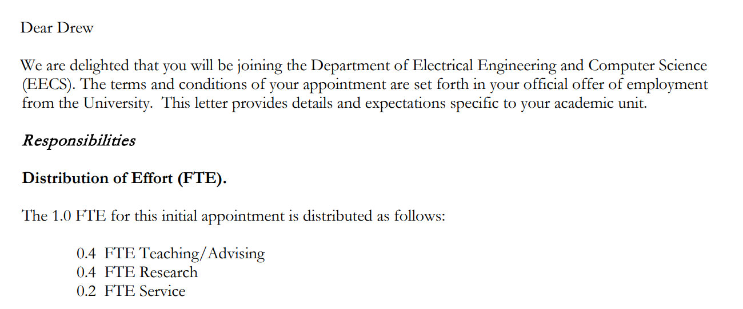
About Us – The Academic Model
Teaching /
Advising
EECS 700
Research
Office Hours (2 hours)
EECS 665
Service
Lecture Prep (~3 hours)
Lectures (3 hours)
8 Hours (EECS 665)
16 Hours (Teaching)
40 Hours (FTE)

Slide 6
About Us – The Academic Model
Takeaways
Professors are busy!
But Office Hours are just for you
Delays in grading and email can happen
Grading
Email / Questions
Course Admin
Teaching /
Advising
Advising
EECS 700
Assignment / Exam Prep
Research
Office Hours (2 hours)
EECS 665
Service
Lecture Prep (~3 hours)
Lectures (3 hours)
8 Hours (EECS 665)
16 Hours (Teaching)
40 Hours (FTE)

Slide 7

About the Course
I’ve taught this course once before (as a graduate student)
It went well! But…
I’ve never taught YOU this course before
Feel free to email me your thoughts, suggestions, etc.
Piazza: anonymous posting is currently enabled
If you have criticisms, I’d prefer a private message

Slide 8
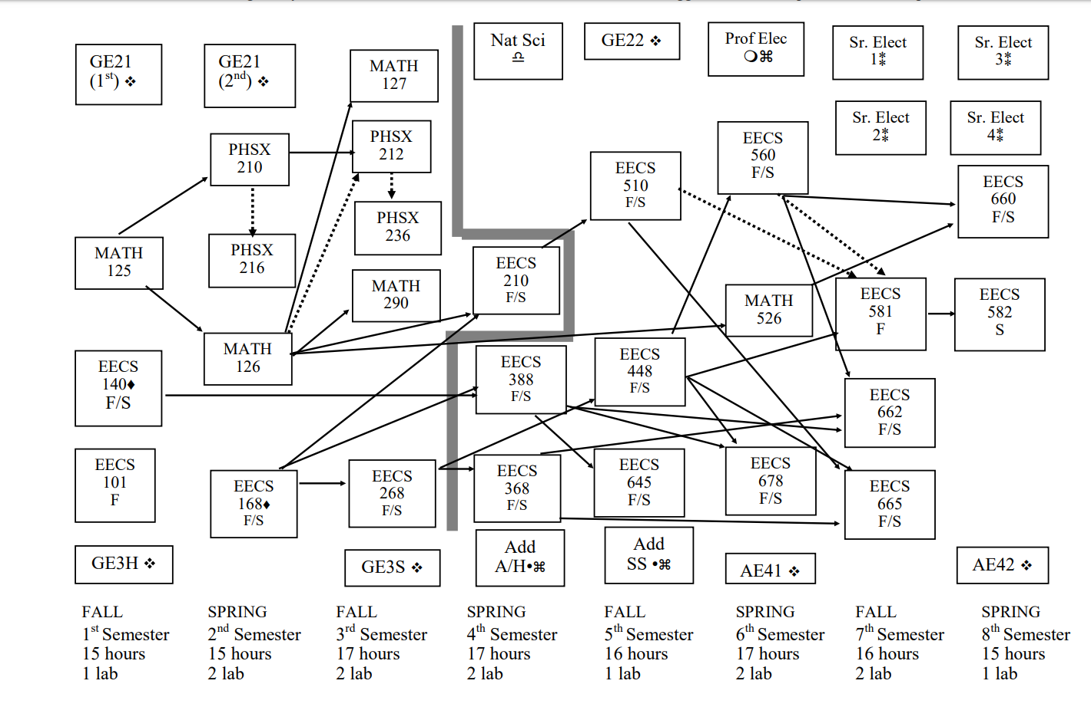
About the Course
Oh hey, this course is required
I hope to teach you skills beyond just compiler writing

Slide 9
There’s a lot of material to cover!
(I think) Compilers is a fun course
It’s where “the rubber meets the road” for programming language abstractions
Get to see the abstractions actually pulling some weight
Get to see the limits of the abstractions
Get some glimpses into how complexity / computability results matter in practice

Slide 10
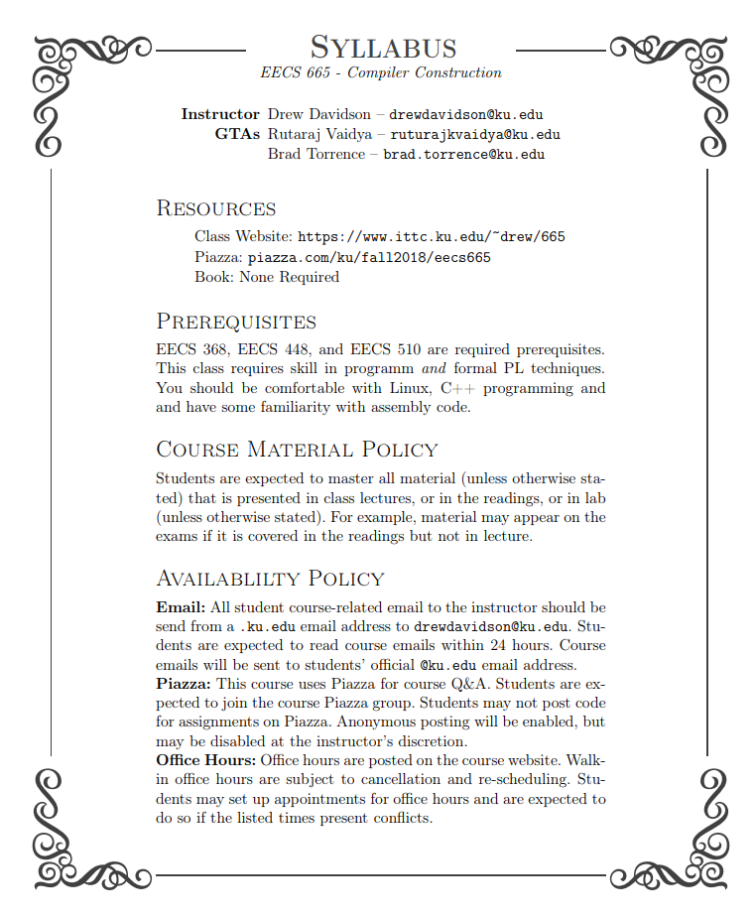
Logistics - Where to Start
Check course website schedule:
https://ittc.ku.edu/~drew/665
Read the syllabus
I’ll overview some key points now, but…
You’re expected to know everything on it
We’ll go over it a bit more in lab this week

Slide 11
Logistics - Labs
We WILL have labs this week
I’ll actually be teaching (for this week only)
We’ll go over all of the course policies
We’ll help you fill any prerequisite gaps in your knowledge
Labs will consist of short supplemental materials to the course / short graded assignments

Slide 12
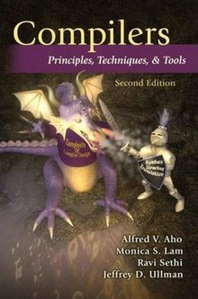
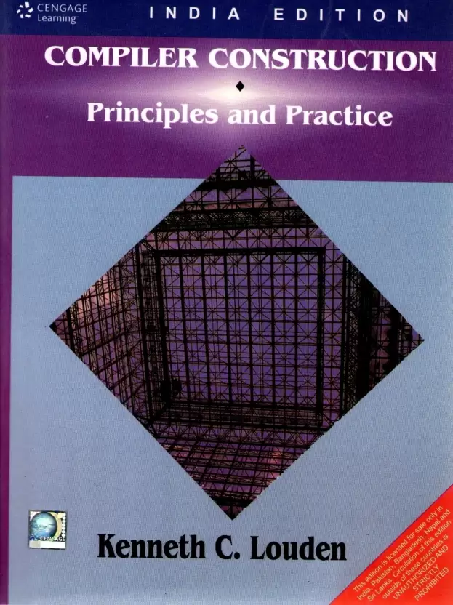

Logistics - Readings
There is no textbook for this course
There are a set of readings that will be posted to the schedule page
Reading are also available from the materials section
If you feel you’d benefit from a textbook, the following are reasonable choices:
Free!

Slide 13
Logistics – Questions?
This is a good time to ask any questions about course logistics
But we’re going to have time in a small-group setting (lab) for more Q&A.
But also, if you have a question you can use email or Piazza

Slide 14

Time to Dive in!

Slide 15
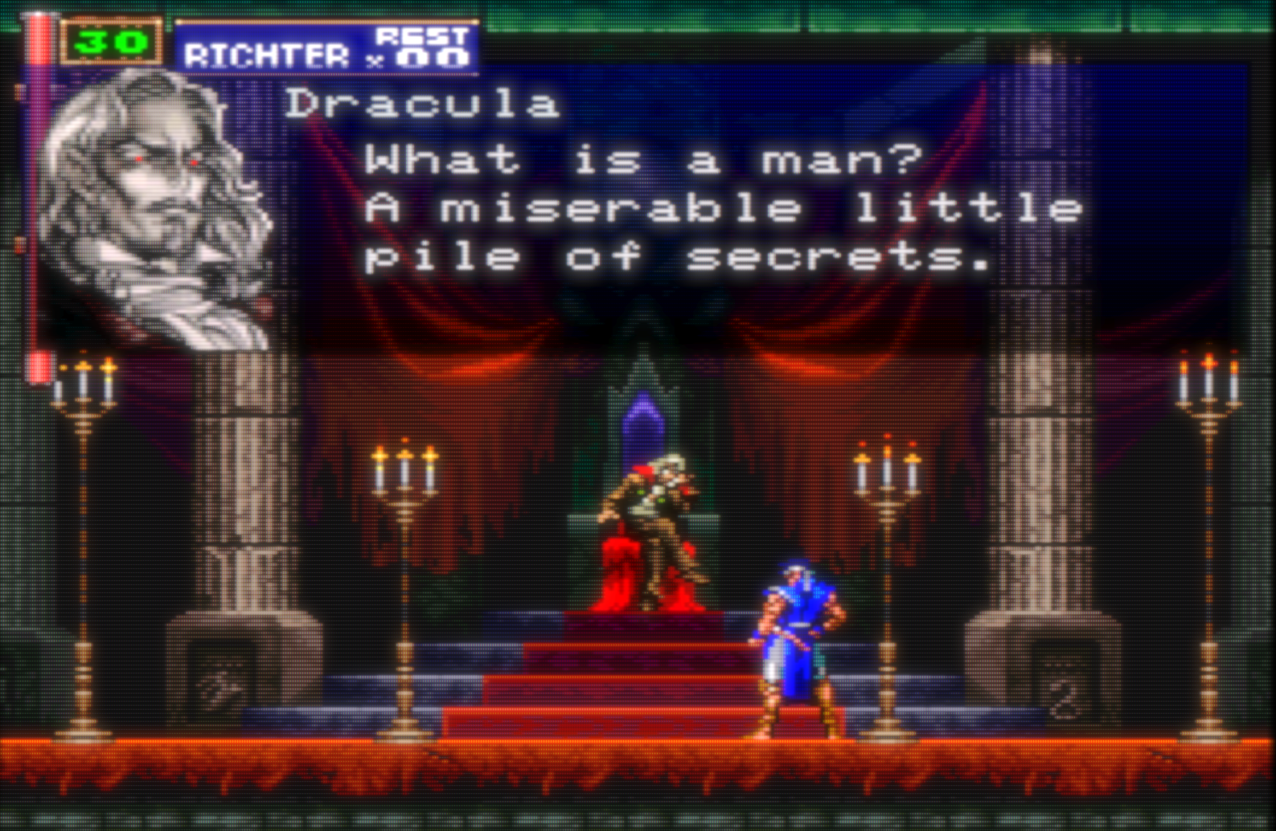
First Look: What is a Compiler?
A pipeline of components to translate a source language S into a target language T
Traditionally, a compiler translates a language with more abstractions into one with fewer abstractions
Compiler

Slide 16
Possible Compiler Components
Source code (sequence of chars)
Scanner
Lexical analysis
Note: We’ll go over each of the components in lab this week
Parser
Syntactic analysis
Semantic analysis
Symbol Table
IR (Intermediate Representation) code generation
IR optimization
Code generation
Machine code optimization
Output code in T

Slide 17
Possible Compiler Components
Source code (sequence of chars)
From characters to tokens
Scanner
Lexical analysis
Note: We’ll go over each of the components in lab this week
Parser
Syntactic analysis
Semantic analysis
Symbol Table
IR (Intermediate Representation) code generation
IR optimization
Code generation
Machine code optimization
Output code in T

Slide 18
Possible Compiler Components
Source code (sequence of chars)
From characters to tokens
Scanner
Lexical analysis
Note: We’ll go over each of the components in lab this week
Parser
Syntactic analysis
Symbol Table
Semantic analysis
IR (Intermediate Representation) code generation
IR optimization
Code generation
Machine code optimization
Output code in T

Slide 19

Scanning: From Chars to Tokens
x+++y++
Identifier
PostInc
Add
Identifier
PostInc
x
++
+
y
++
Deterministic
Finite
Automata

Slide 20
FSMs: Why?
Powerful enough for regular languages
“Good enough” for tokenization

Slide 21
FSMs: Review By Example
S
‘/’
1
‘/’
2
‘\n’
3
3
not ‘\n’
Input:
“//”
“//In comment //”
“//Line 1\nLine 2”
“//Line 1\n//Line 2”

Slide 22
FSMs: Review By Example
S
‘a’
S1
‘b’
S2
What language does
this automaton accept?
‘a’
Input:
“a”
S
‘a’
S1
What language does this
automaton accept?
“aa”
“ab”
‘b’
“”
“abab”

Slide 23
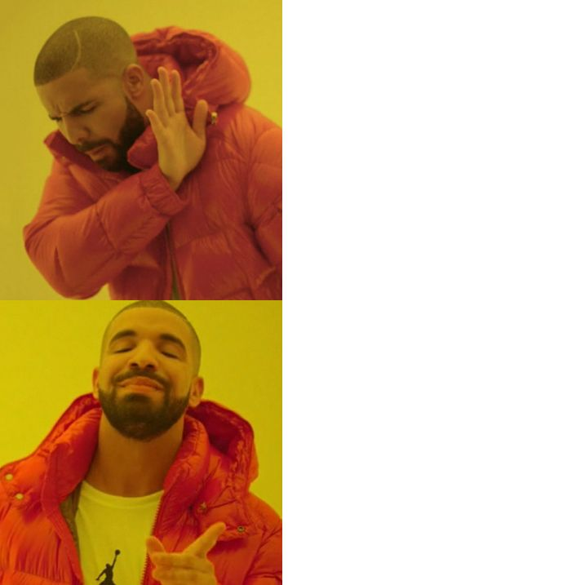
DFAs: Deterministic Finite Automata
Always an unambiguous transition
S
‘a’
S1
‘b’
S2
‘a’
S
‘a’
S1
‘b’
S2
‘a’
‘a’

Slide 24
Project 1: Out tonight!
Implement a DFA matching engine
Given
S
‘a’
S1
‘b’
S2
“ab”
‘a’
Output
“1” – DFA accepts string
“0” – DFA rejects string

Slide 25
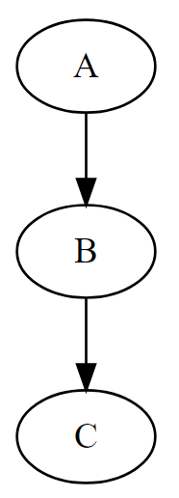
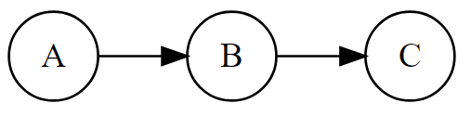
Project 1: How do you read a graph?
Graphviz’s Dot/Dotty !
digraph { A -> B
B -> C
}
Some directives for more DFA-like output
digraph { rankdir=LR;
node [ shape = circle];
A -> B
B -> C
}

Slide 26
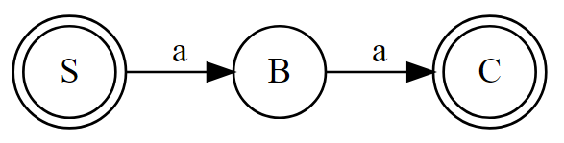
Project 1: Graphviz DFAs
Node annotation
For accept states
Designated
start state S
digraph { rankdir=LR;
node [shape=doublecircle]; C S
node [shape=circle];
S -> B [label=a]
B -> C [label=a]
}
Edge annotation
For transitions

Slide 27
Project 1: Visualizing Dot graphs
Available as a Linux package
apt install graphviz
dotty file1.dot
Available :
I’ll probably host a service at some point
http://www.webgraphviz.com/
http://viz-js.com/

Slide 28
Project 1: Getting Started
Guidelines will be posted tonight
Due Friday of Next week (8/31)
I’ve written a (very flaky) parser for a subset of Dot that you can use
We’ll only be testing on correct DFAs (no error handling required)

Slide 29
Next…
Look at FSM formalisms, NFAs (ambiguous transitions)
Enroll in Piazza
Look out for the Project 1 assignment
https://www.ittc.ku.edu/~drew/665/assignments/
Read through the syllabus
https://www.ittc.ku.edu/~drew/665/syllabus.pdf
Go through the readings for FSMs and the compiler overview
https://www.ittc.ku.edu/~drew/665/readings/
Go to lab
I’ll personally be kicking off EVERY lab this week to make sure we get off to a strong start

Slide 30
Bye until next time!

